Slide 1
Dreamweaver Domain 1: Setting Project Requirements
Adobe Creative Suite 5
ACA Certification Preparation:
Featuring Dreamweaver, Flash, and Photoshop
1
1

Slide 2
About the Presentations
The presentations cover the objectives found in the opening of each domain.
All domain objectives are listed in the beginning of each presentation.
You may customize the presentations to fit your class needs.
Some figures from the domain are included. A complete set of images from the book can be found on the Instructor Resources disc.
2
2

Slide 3
Objectives
Identify the purpose, audience, and audience needs for a website.
Identify web page content that is relevant to the website purpose and appropriate for the target audience.
Demonstrate knowledge of standard copyright rules (e.g., related terms, obtaining permission, and citing copyrighted material).
3
3

Slide 4
Objectives (continued)
Demonstrate knowledge of website accessibility standards that address the needs of people with visual and motor impairments.
Make website development decisions based on your analysis and interpretation of design specifications.
Understand project management tasks and responsibilities.

Slide 5
Vocabulary
Checkpoints
Copyright
Copyrighted
Deliverables
Derivative work
Design comp
Fair use doctrine
Intellectual property
Publication
Target audience
Wireframe
5
5

Slide 6
Domain 1.0 Setting Project Requirements
This domain focuses on setting project requirements.
This domain is similar to the first domain in the Rich Media Communication and the Visual Communication certification objectives.
6
6

Slide 7
Objective 1.1 Identify the Purpose, Audience, and Audience Needs for a Website
The first step in creating a website is to define the purpose or vision for the site.
It is important to determine the target audience; that is, who will be using the content, as you begin to create a website in Dreamweaver.
Characteristics of the audience to consider are age, occupation, gender, education, residence, ethnicity, and computer literacy.
7
7

Slide 8
Objective 1.2 Identify Web Page Content that is Relevant to the Website Purpose and Appropriate for the Target Audience
Once you have identified the purpose, goals, and audience of the website, it is important to develop content that is relevant to the purpose and appropriate for the target audience.
8
8

Slide 9
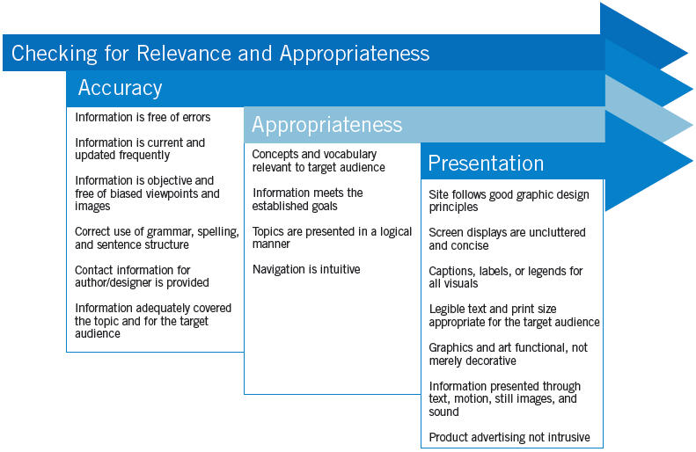
Objective 1.2 Identify Web Page Content that is Relevant to the Website Purpose and Appropriate for the Target Audience (cont.)
9
9

Slide 10
Objective 1.3 Demonstrate Knowledge of Standard Copyright Rules (Related Terms, Obtaining Permission, and Citing Copyrighted Material)
Intellectual property refers to creations of the mind and may include copyrights, trademarks, patents, industrial design rights, and trade secrets.
Copyright is a category of intellectual property providing protection to the authors of “original works of authorship.”
The 1976 Copyright Act defines publication as the distribution of copies of a work to the public by sale or other transfer of ownership, or by rental, lease, or lending.
10
10

Slide 11
Objective 1.3 Demonstrate Knowledge of Standard Copyright Rules (Related Terms, Obtaining Permission, and Citing Copyrighted Material) (cont.)
A derivative work is a work that is based on or derived from one or more existing works (and previously published).
The fair use doctrine allows copyrighted work to be reproduced for a variety of reasons including news reporting, teaching, parody, and research.
Simply recognizing the source of the copyrighted information is not a substitute for getting permission, and except in cases of fair use, you must obtain permission for all protected material you want to use.
11
11

Slide 12
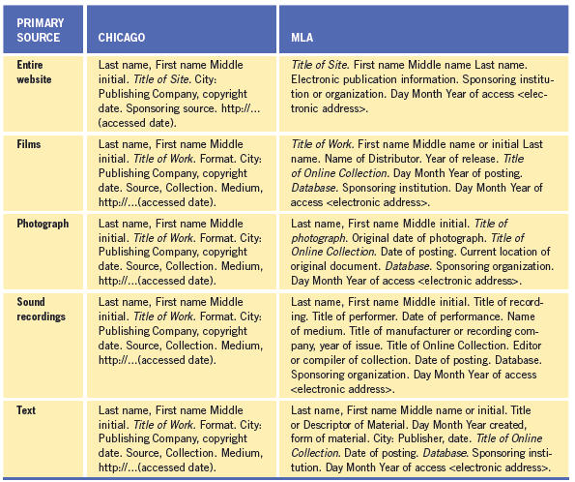
Objective 1.3 Demonstrate Knowledge of Standard Copyright Rules (Related Terms, Obtaining Permission, and Citing Copyrighted Material) (cont.)
12
12

Slide 13
Objective 1.4 Demonstrate Knowledge of Website Accessibility Standards that Address the Needs of People with Visual and Motor Impairments
You should design websites to make certain that each user, including those who may have trouble seeing or hearing or who may have motor impairments, can use them.
Website Accessibility Standards:
Standards, known as checkpoints, have been created to make the Internet accessible to individuals with disabilities.
13
13

Slide 14
Objective 1.4 Demonstrate Knowledge of Website Accessibility Standards that Address the Needs of People with Visual and Motor Impairments (cont.)
The POUR Principles:
Perceivable content is information that is not invisible to all senses; the content is presented in a manner that permits users to comprehend it despite their disability.
Operable content means any user, no matter the disability, is still able to operate the interface and use the navigational elements.
14
14

Slide 15
Objective 1.4 Demonstrate Knowledge of Website Accessibility Standards that Address the Needs of People with Visual and Motor Impairments (cont.)
The POUR Principles (cont.):
Understandable content includes giving the user the ability to navigate the interface and ensuring that the information is comprehendible.
Users should access robust content through the various assistive technologies, and robust content should continue to work even as these assistive technologies improve.
15
15

Slide 16
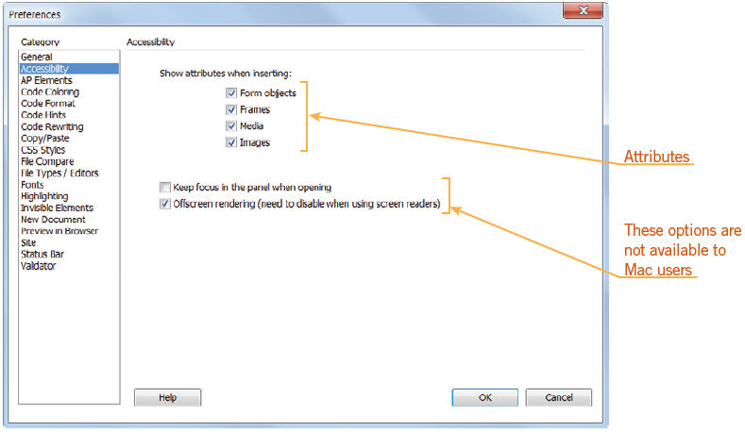
Objective 1.4 Demonstrate Knowledge of Website Accessibility Standards that Address the Needs of People with Visual and Motor Impairments (cont.)
Consider Screen Readers:
Screen readers can read certain elements in a web page to assist those users with visual impairments.
16
16

Slide 17
Objective 1.4 Demonstrate Knowledge of Website Accessibility Standards that Address the Needs of People with Visual and Motor Impairments (cont.)
Why Do Accessibility Standards Matter to the Target Audience and Your Client?
Members of the target audience may have disabilities; if the website is not accessible to them, your website will be useless to that user.
When designing a website, it is important to create a website that will be efficient, easy to learn, and satisfying for all users.
17
17

Slide 18
Objective 1.5 Make Website Development Decisions Based on Your Analysis and Interpretation of Design Specifications
When designing a website, you should consider the relationship between end-user requirements and the design and development process.
Deliverables are the items identified to show design concepts or progress of the project.
A wireframe is a basic visual guide that suggests the structure of an interface and the relationships between its pages.
18
18

Slide 19
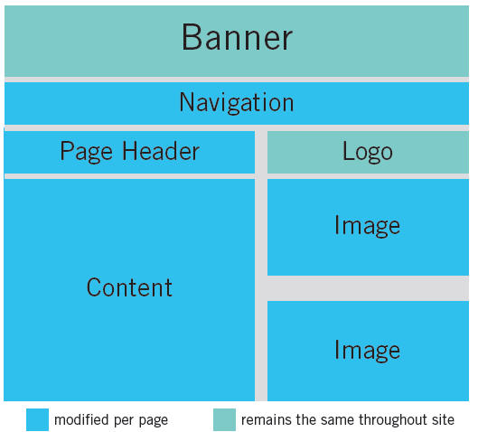
Objective 1.5 Make Website Development Decisions Based on Your Analysis and Interpretation of Design Specifications (cont.)
Wireframes should contain all the important elements of a web page.
19
19

Slide 20
Objective 1.6 Understand Project Management Tasks and Responsibilities
Planning is the most important part of any successful project. It is important to create a plan for working on a project whether you are working alone, as part of a team, or for a client.
Stage 1—Planning and Analysis
Stage 2—Scheduling
Stage 3—Building
Stage 4—Testing
Stage 5—Implementing or Publishing
20
20

Slide 21
Summary
Objective 1.1 Identify the Purpose, Audience, and Audience Needs for a Website
Objective 1.2 Identify Web Page Content that is Relevant to the Website Purpose and Appropriate for the Target Audience
Objective 1.3 Demonstrate Knowledge of Standard Copyright Rules (Related Terms, Obtaining Permission, and Citing Copyrighted Material)
21
21

Slide 22
Summary (cont.)
Objective 1.4 Demonstrate Knowledge of Website Accessibility Standards that Address the Needs of People with Visual and Motor Impairments
Objective 1.5 Make Website Development Decisions Based on Your Analysis and Interpretation of Design Specifications
Objective 1.6 Understand Project Management Tasks and Responsibilities
22
22

